Slide 1

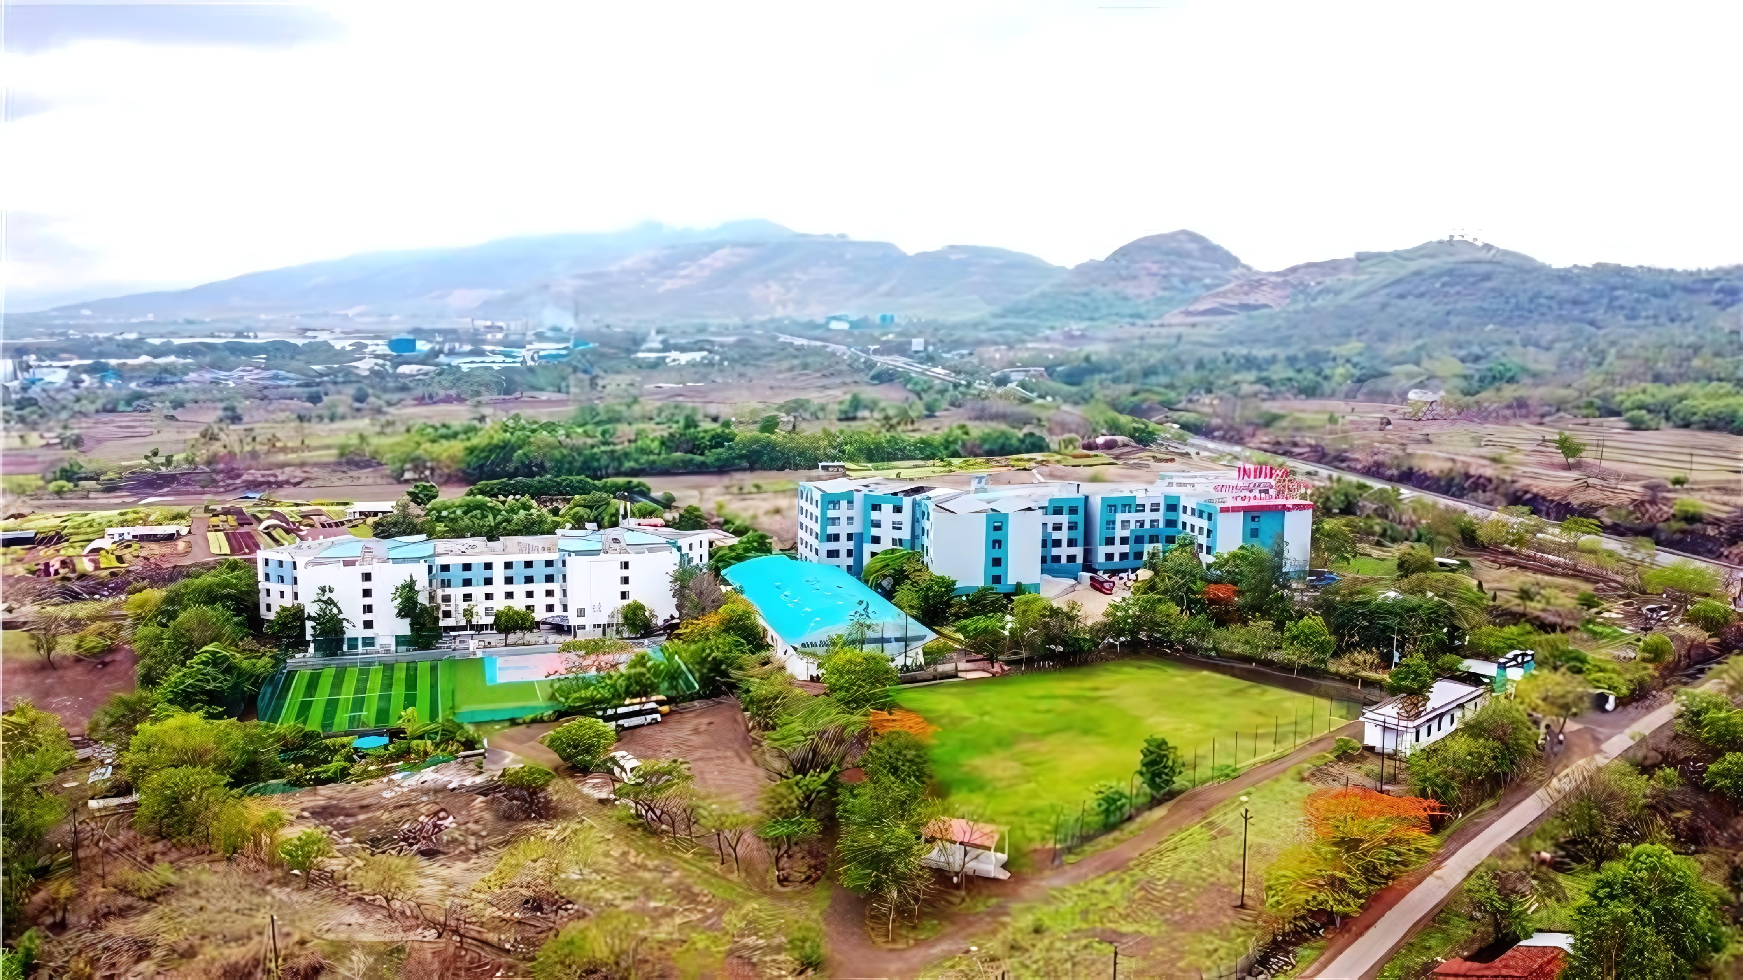


Department of Artificial Intelligence & Data Science
Academic Year 2026–2027
MINI PROJECT REVIEW – 2
EduVerse AI
An Animated Virtual Tutor
for Personalized Learning
PRESENTED BY
Aryan Shinde
Huzaifa Sheikh
Sufiyan Surve
Notes:
Official ICEM cover composition restored from the supplied original presentation. EduVerse AI is a proposed AI learning workflow. No implementation status or performance result is implied.

Slide 2


Agenda
Introduction
01
Implementation
05
Aim & Objectives
02
Applications
06
Tools Used
03
Future Scope
07
System Overview &
Proposed Solution
04
Conclusion & References
08
02 / 08
www.indiraicem.ac.in
Notes:
The eight agenda sections are covered within eight slides. Tools and system overview share slide 5. Applications and future scope share slide 7.

Slide 3




Introduction
Study material is available. Contextual interaction is often missing.
THE PROBLEM
THE GAP
OUR IDEA
EduVerse AI
Students commonly depend on
PDFs, notes and videos.
Static Content
↓
An AI-powered virtual tutor that connects study material with contextual Q&A, explanations and quiz-based practice.
Limited Interaction
Specific doubts may require
contextual explanations.
↓
Manual Practice
Creating practice questions from
study material takes extra effort.
↓
Disconnected Feedback
One learning workflow
UPLOAD
→
UNDERSTAND
→
ASK
→
EXPLAIN
→
PRACTICE
→
REVIEW
03 / 08
www.indiraicem.ac.in
EduVerse AI · Mini Project Review–2
Notes:
Students already have learning material but may need help interpreting it. EduVerse AI proposes one interface for asking material-related questions and creating practice. Personalized here means adapting to the selected material and student questions, not a validated adaptive learning model.

Slide 4




Aim & Objectives
AIM
To develop an AI-powered animated virtual tutor that helps students interact with study material, obtain contextual explanations and practise concepts through automatically generated quizzes.
01
Interactive AI Tutor
04
Simplified Explanations
Support student questions through a tutor interface.
Explain difficult concepts with clear examples.
EduVerse
AI
02
Study Material Understanding
05
AI Quiz Generation
Extract usable text from uploaded documents.
Generate practice questions from learning material.
AI Learning Workflow
03
Contextual Q&A
06
Learning Feedback
Use selected material to answer student doubts.
Show quiz results and topics to revisit.
04 / 08
www.indiraicem.ac.in
EduVerse AI · Mini Project Review–2
Notes:
The six objectives describe planned capabilities. Document understanding means converting a PDF to text and using an appropriate excerpt in an AI request. Quiz feedback begins with checking a selected answer against the stored answer key. The avatar presents the explanation, while the LLM generates text.

Slide 5
System Architecture & Technology Stack
Proposed design for a focused undergraduate prototype
PROPOSED TECHNOLOGY STACK
PROPOSED SYSTEM FLOW
Frontend
Student
Web interface
Backend / API
React
Upload • Ask • Practice
Frontend · React
Coordinates requests
Backend
Python / FastAPI
Study material processing
User query
AI layer
LLM API
PDF / Notes
Text extraction
Document context
Document processing
Selected study material
PyMuPDF → usable text
Combined with user query
PyMuPDF
Data storage
Database
Version control
AI uses the question together with the extracted study material.
Q&A / Explanation
AI / LLM Processing
Git / GitHub
OR quiz generation
Generate a contextual output
API testing
Postman
Avatar
Result / Feedback
Tutor interface
Web-based avatar technology
Response or quiz feedback
UI presentation layer
05 / 08
www.indiraicem.ac.in
EduVerse AI · Mini Project Review–2
Notes:
Proposed architecture, not verified implementation. The student interacts with the web frontend. The backend accepts study material and questions. PyMuPDF extracts machine-readable text from a text-based PDF. The backend combines document context with the user query before calling an LLM API. The model generates an explanation or quiz questions. For quizzes, submitted answers can be checked against an answer key. The result is displayed in the tutor interface, which is a UI presentation layer, not a separate AI engine. A database is proposed but no product is specified. Scanned PDF support requires OCR outside the stated core flow. References: https://react.dev/ https://fastapi.tiangolo.com/ https://pymupdf.readthedocs.io/en/latest/

Slide 6






Implementation / Prototype
Conceptual Prototype UI · Illustrative content
● ● ●
EDUVERSE AI
Conceptual Prototype UI
LEARNING SPACE
Welcome to EduVerse AI
VIRTUAL TUTOR
Dashboard
Uploaded material
Machine Learning Basics.pdf
Study Material
AI TUTOR
AI Tutor
What would you like to understand?
Quiz
Student: Explain supervised learning in simple terms.
Virtual Tutor Concept
Progress
AI Tutor: Supervised learning is a machine learning approach where a model learns from labelled examples.
Quiz Progress
Quiz not started
Ask Tutor
Generate Quiz
01
02
03
04
05
06
PDF Upload
→
Text Extraction
→
AI Processing
→
Q&A
→
Quiz Generation
→
Result
06 / 08
www.indiraicem.ac.in
EduVerse AI · Mini Project Review–2
Notes:
Conceptual Prototype UI, not a screenshot of a working application. The PDF filename and conversation are illustrative. The Virtual Tutor Concept uses an AI-generated flat illustration and is not a working animated avatar. Workflow: PDF upload, text extraction, AI processing, Q&A, quiz generation and result. No implementation results or performance measurements are claimed.

Slide 7





Applications & Future Scope
Practical learning scenarios and a phased development roadmap
APPLICATIONS
FUTURE ENHANCEMENTS
Student Self-Learning
1
Voice Interaction
Independent study and revision.
Speech-to-Text and Text-to-Speech
2
Personalized Recommendations
Exam Preparation
Suggest topics based on learning needs
Turn material into explanations and practice.
Learning Analytics
3
Concept Revision
Track learning activity and progress
Quickly revisit difficult topics.
4
Multi-language Support
Explain concepts in more languages
AI-Based Practice
5
Adaptive Quiz Difficulty
Generate quizzes from learning material.
Adjust questions using previous answers
Interactive Digital Learning
6
Mobile Application
Study through an AI-assisted interface.
Access the learning workflow on mobile
Advanced development: RAG-based document grounding
and an advanced 3D animated tutor.
07 / 08
www.indiraicem.ac.in
EduVerse AI · Mini Project Review–2
Notes:
All future enhancements are planned additions to the core concept of study material, AI Q&A, explanation and quiz practice. Voice interaction converts speech to text and text to speech. Personalized recommendations may use student needs and topic history. Adaptive difficulty would use previous answers. RAG would retrieve relevant document passages before generation. These features require implementation and evaluation. Applications are intended use cases, not demonstrated learning outcomes.

Slide 8

Conclusion & References
CONCLUSION
EduVerse AI aims to integrate study-material processing, contextual Q&A, explanation generation and quiz-based practice into a unified learning workflow. The project explores how generative AI can support interactive and self-directed learning.
KEY TAKEAWAY
Study Material → AI Understanding → Interactive Tutor
→ Practice → Feedback
REFERENCES
React Documentation
FastAPI Documentation
PyMuPDF Documentation
Thank You!
Presented By
Aryan Shinde • Huzaifa Sheikh • Sufiyan Surve
08 / 08
Notes:
The conclusion describes the project aim and proposed workflow. No measured learning outcomes or completed production integration are claimed. Relevant official documentation: React https://react.dev/; FastAPI https://fastapi.tiangolo.com/; PyMuPDF https://pymupdf.readthedocs.io/en/latest/. No specific LLM provider or avatar library is confirmed in the proposed stack.

